Slide 1

Teaminator 3 GT Bootcamp Project 3 Final Presentation
Jacqueline Gonza
Leeandrew Long
Lekh Malla
Andres Pulido
Chris Torkelson
April 2022

Slide 2
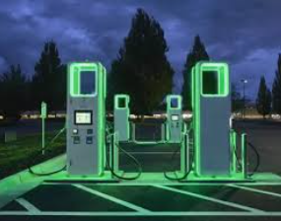
Discussion Agenda
Electric Vehicle Charging
Overview of our Project
Explanation of our Approach
Show our Results

Slide 3

Sales of Electric Vehicles are increasing each year and the demand for EV Charging Stations is increasing at a similar rate.
We created a website that maps EV Charging stations throughout the US that would allow owners of electric vehicles to plan where they can recharge if they are traveling outside their typical charging radius.

Slide 4
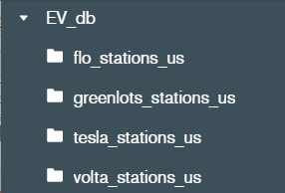
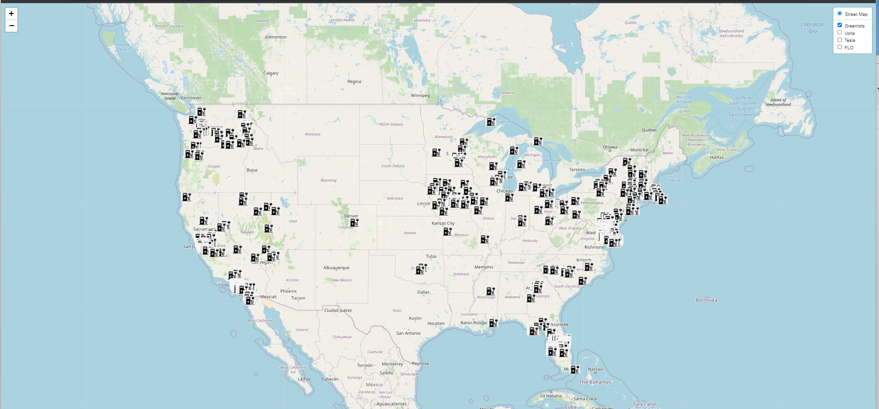

NREL API
Mongo DB
Python
4 EV Charging Providers
> 3000 Stations
Project Summary
EV Charging Station Map
(Leaflet, HTML, CSS, JavaScript, jQuery)
FLASK Server
Python / PyMongo)

Slide 5
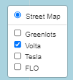
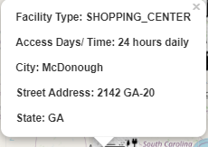
EV Charging Stations
Demo

Slide 6
Future Enhancements
Create ability to select starting and ending points and map the route with EV Stations to enable EV selection along the route.
Create ability to select a state and see all EV Stations in that state
Create ability to select “Free” vs “Pay” stations
Create ability to create marker clusters

Slide 7
Questions

Slide 8
Additional Slides

Slide 9
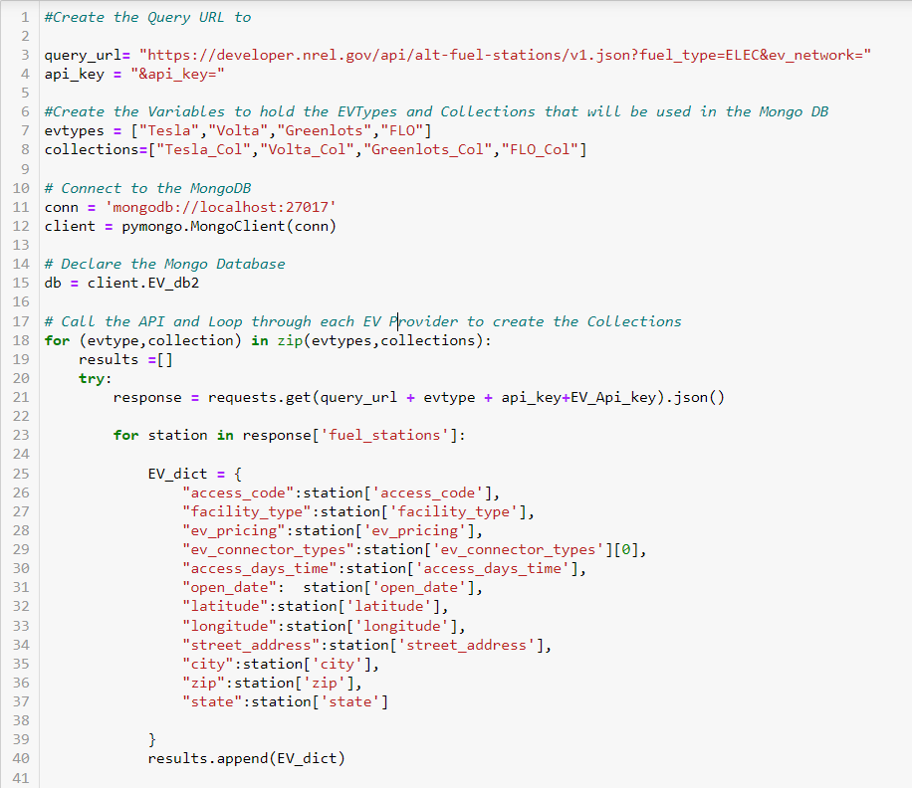
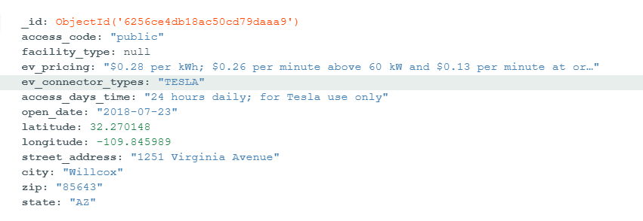
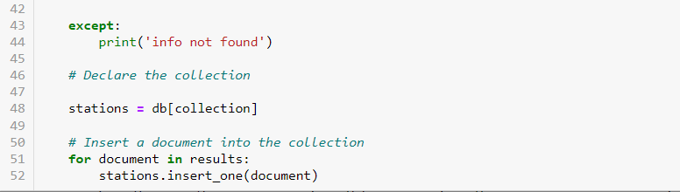
NREL API Call
Initially pulled the information for each provider in separate calls and added them to the Mongo DB.
Refactored the code to create a For Loop using ZIP that looped through each provider and
Refactored Code
Was able to reduce the initial code that had over 200 lines down to just over 50 lines that used a ZIP function to loop through each provider and create a collection for each
Document / Object Example

Slide 10
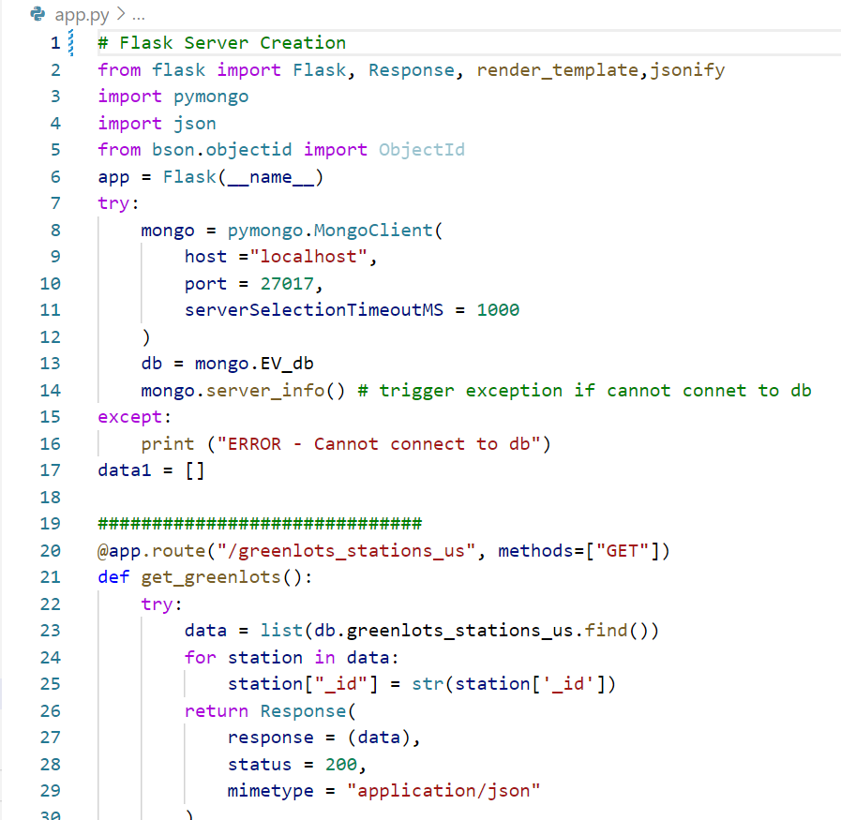

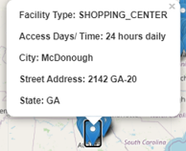
Flask Server
Created 4 Routes that allow users to select the EV Providers that they want to view.
Tesla
Volta
Greenlots
FLO
Provided key information on each station when selected
Facility Type
Access Days/Time
City
Street
State

